Slide 1
Seed Investment in Toronto

Slide 2
Introduction
For my business problem, I'll be analyzing localities in Canada to assess their viability for seed fund investment for potential new companies. With the expansion of modern society and technology, along with the political landscape of the United States, many companies and venture capitalists are flocking to Canada in order to start new companies and consumer hotspots. In fact, last year Toronto itself grew at a rate of almost 2.4% annually since 2009 and constitutes almost 20% of Canada's national GDP. Accordingly, it's important to understand the various localities in Canada, and what they have to offer in terms of population centers which can be found using clustering maps and various strategies.

Slide 3
Data
I'll be using data from Foursquare, and various areas that are hotspots in the Toronto area (which is the fastest growing area in Canada). This will primarily be constituted of various restaurants that are popular in the Toronto area, From there, I'll be deciding which area is the best for seed investment and growth. My data will be helpful in the purpose of my observation for several reasons. This will allow me to determine the best areas in which to invest, as I can see where the most popular locations are, which will in turn attract the most consumer interaction and consumer expenditure. I can also see the various types of popular habits across the populations, which will allow me to determine the best type of seed investment and be a primary determinant for how diversified my investments will be in the area.

Slide 4
Methodology
My code does several things in order to determine the strongest areas for seed investment, and the various types of seed investments as well. Firstly, I will be dividing Toronto into various types of areas of different demographics and populations known as “Boroughs.” These communities all have different mannerisms, habits, and interests, so I find it important to divide the city (which is already large) into these boroughs so I can see the different areas within Toronto. Then, using Foursquare API data, I will investigate the most popular areas and Points of Interest in these various boroughs, which will allow me to see what will be most well received and what is a suitable area of investment in these different boroughs. Finally, I’ll be visualizing it into clusters to show how Toronto is broken down.

Slide 5
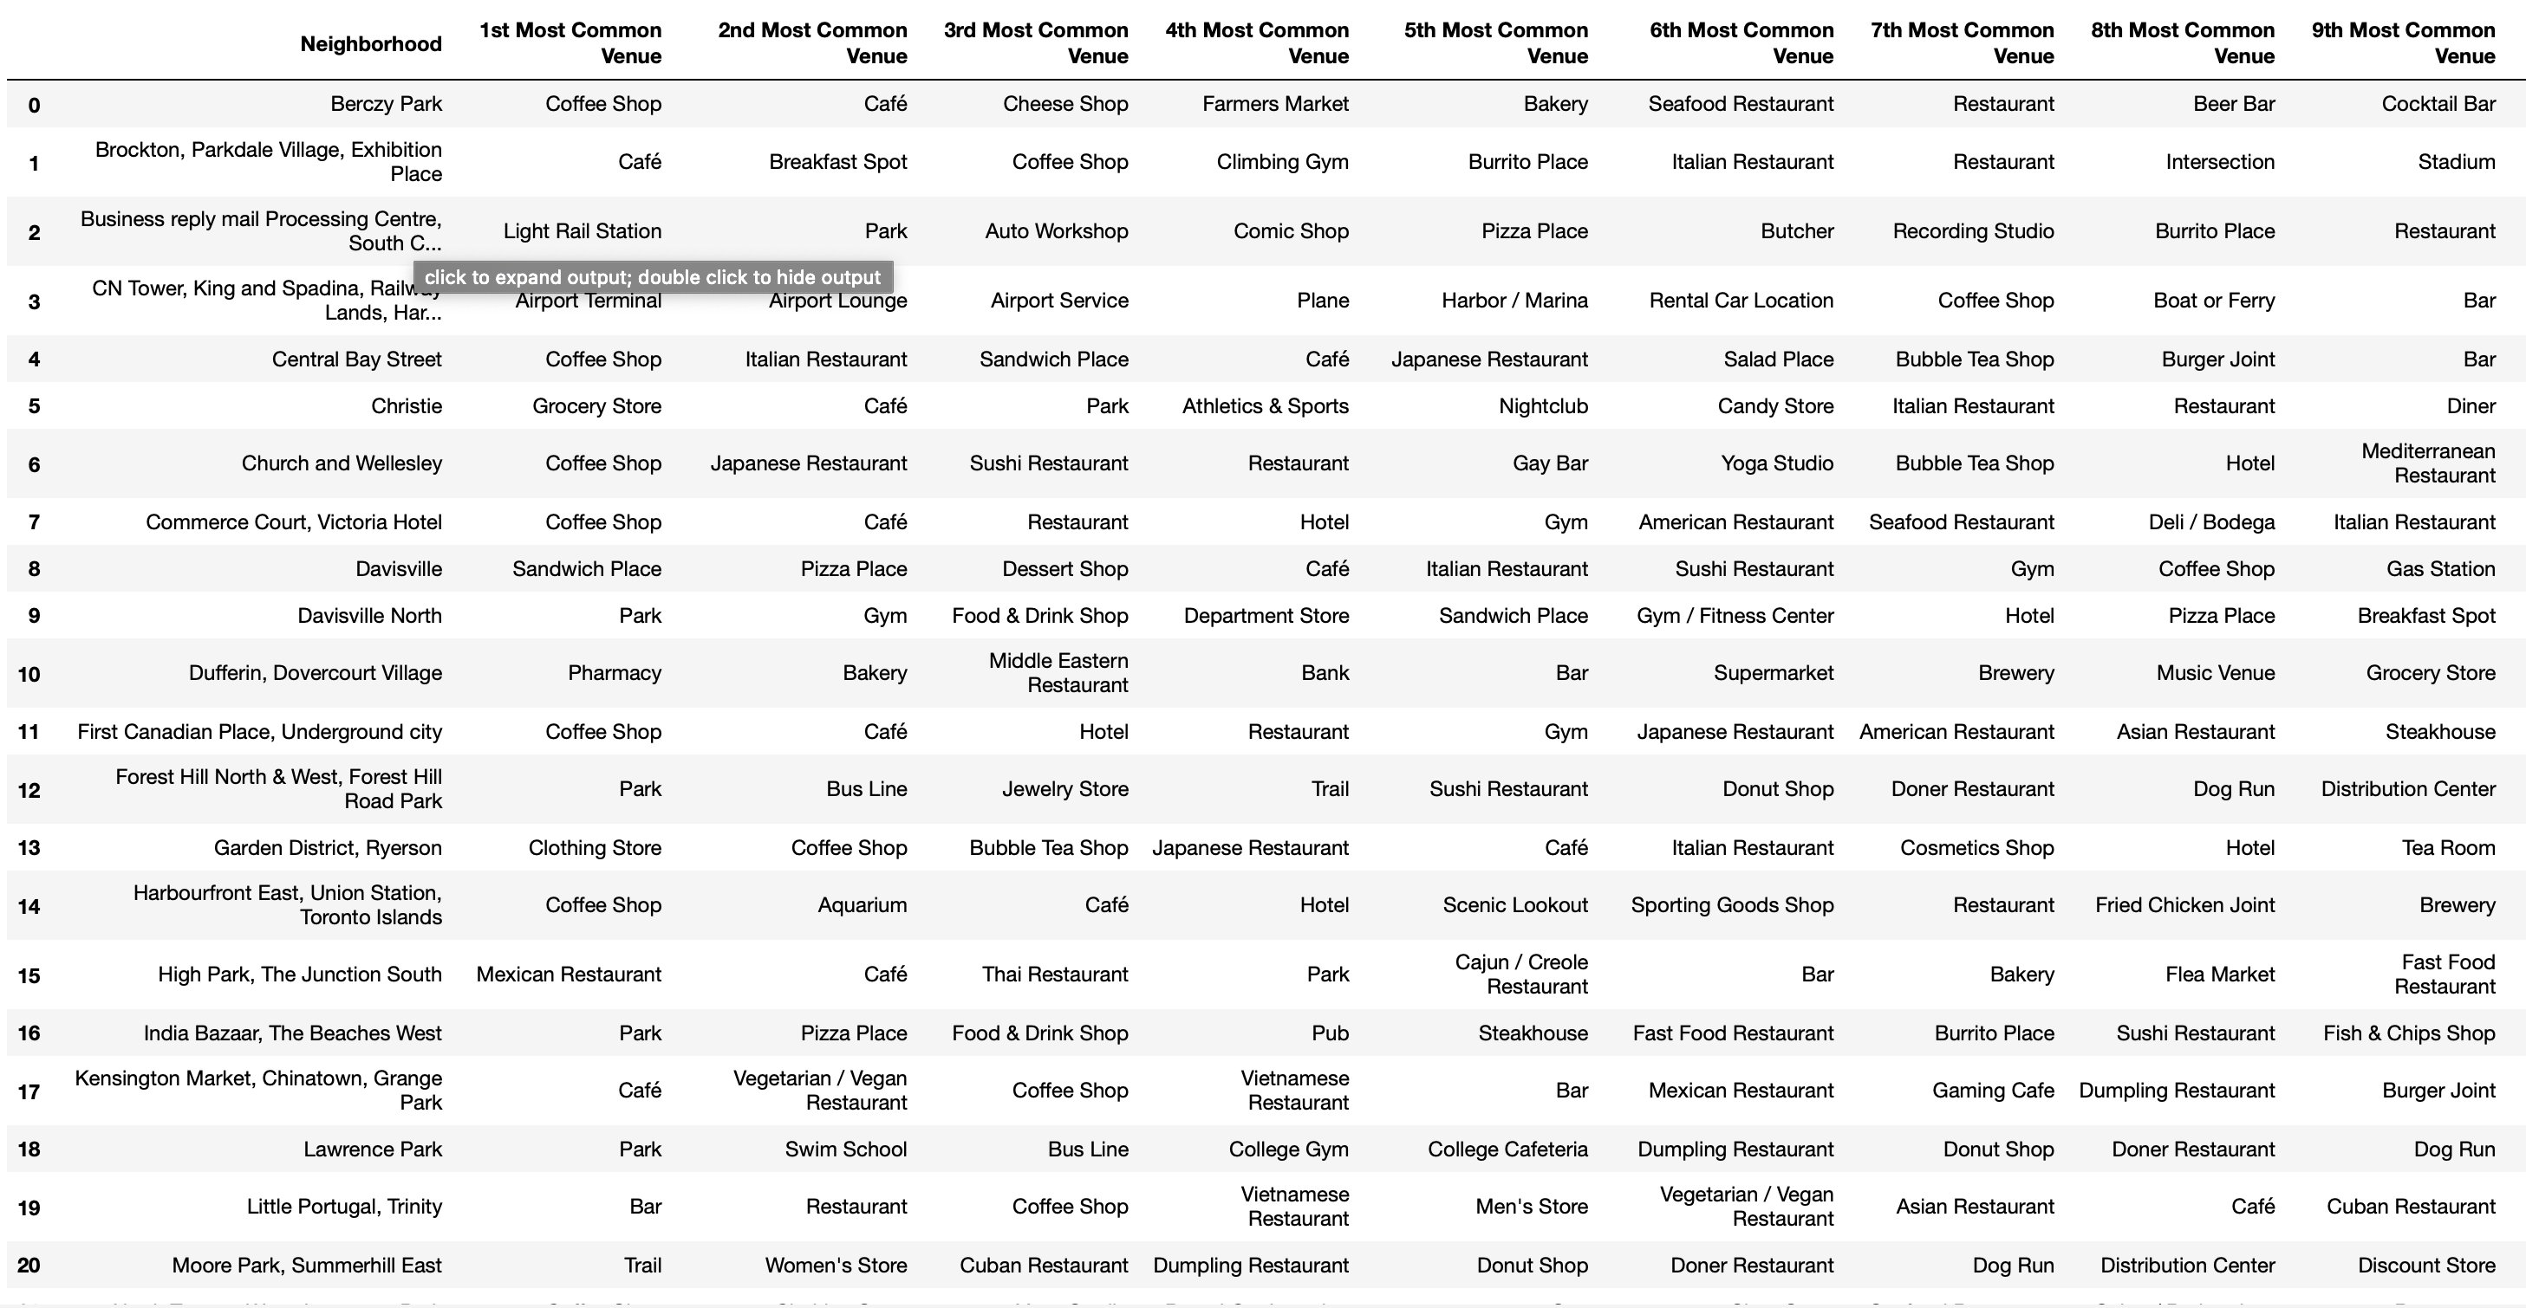
Results
Here is a breakdown of a couple of these neighborhoods. There are several observations that can be made. Firstly, as predicted, each borough has vastly different common venues, which reflect the various tastes and preferences of each neighborhood. At the same time, there are some commonalities. I can use this data in order to find overrepresented venues and also underrepresented venues, which can be leveraged for seed investments into local firms and venues to be built.

Slide 6
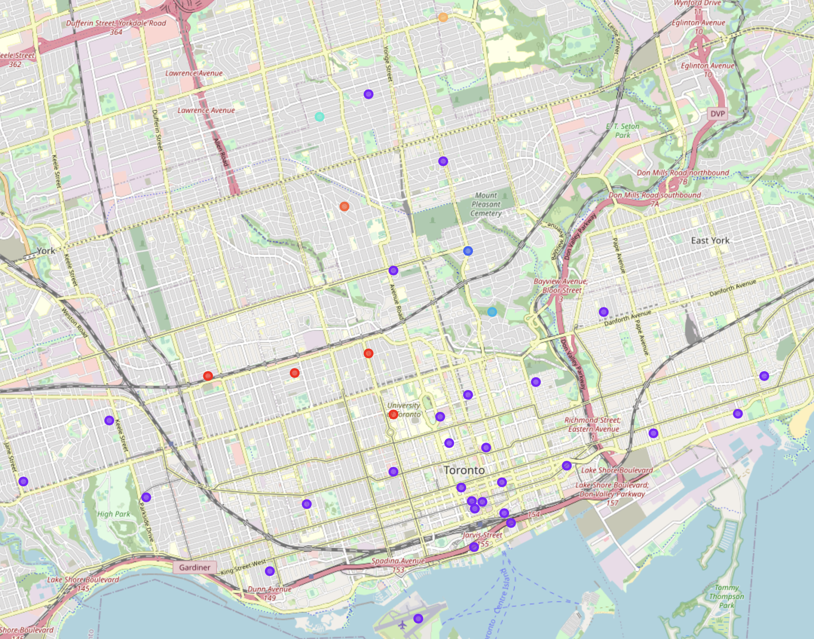
Results Ctd.
This visualization shows the breakdown of Toronto at large, with a couple trends being immediately apparent. Firstly, many of these neighborhoods are inner-city concentrated, which is important for seed investment because residential developments are most likely a non-factor for seed investments. Secondly, many of these boroughs are located very close to each other, but have different common venues, which may be an indication of the fact that different people in “blocks” visit different restaurants and have different habits. This is important when deciding which things to build and which services/companies need to be invested in and developed further.

Slide 7
Discussion
From this exploration, there are several important discoveries. Firstly, seed investments in the city of Toronto will be extremely diversified, due to the fact that many of the boroughs have very different interests and preferences. This is important for the implementation of residential and commercial investments because the potential capital to be used will vary greatly based on the specific borough. Also, the close clustering of the various boroughs is important to notice since it will be imperative for city planners to segment and landscape the area very well in order to properly build and develop the correct establishments in the right areas. If not, then the investments won’t be as successful since the boroughs are all intrinsically diverse.

Slide 8
Conclusion
In this exploration, Toronto was analyzed in order to navigate the various areas of the city and to determine the viability of seed investments in local communities. This was important not only in a hypothetical situation, but in the real world when deciding and deliberating over actual investments into city developments, since all investors in cities and communities need to make the correct decisions when it comes to retail and commercial developments in order to meet demand and increase profitability and GDP for the cities in question. In the future, I would like to look further into the city and perhaps see polling data with individual residents to see what demand is, since there may be gaping holes within the city in regards to establishments that are there and ones that need to be built.

